Slide 1
Basic Image Processing Algorithms
PHALGUNI GUPTA

Slide 2
Image Representation
A digital image is a representation of a two-dimensional image as a finite set of digital values, called picture elements or pixels
The image is stored in computer memory as 2D array of integers
Digital images can be created by a variety of input devices and techniques:
  digital cameras,
  scanners,
  coordinate measuring machines etc.

Slide 3
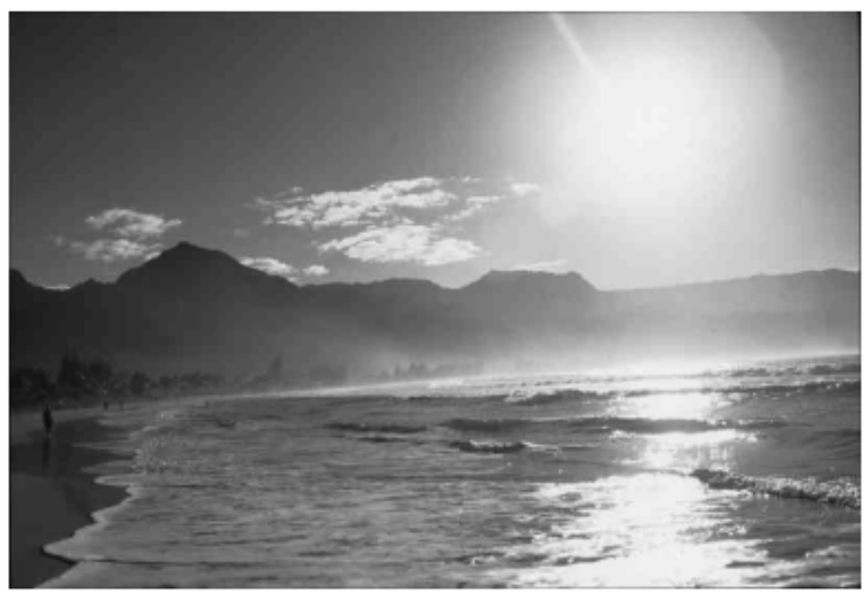
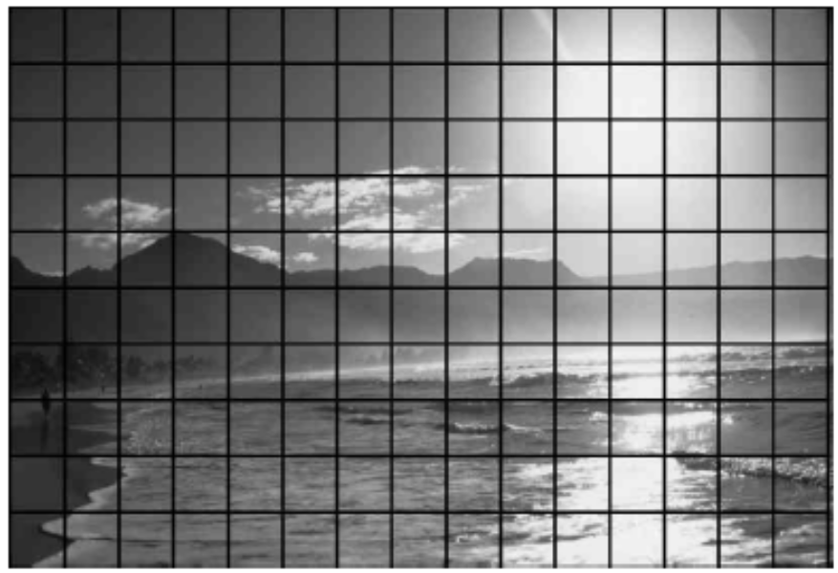
Representation of Digital Images

Slide 4
Types of Images
Digital images can be classified according to number and nature of those samples
  Binary
  Grayscale
  Color

Slide 5
Binary Images
A binary image is a digital image that has only two possible values for each pixel
Binary images are also called bi-level or two-level
A binary image is usually stored in memory as a bitmap, a packed array of bits
Binary images often arise in digital image processing as masks or as the result of certain operations such as segmentation, thresholding.

Slide 6
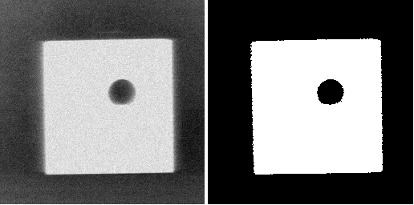
Grayscale Image Binary Image

Slide 7
Grayscale Images
A grayscale digital image is an image in which the value of each pixel is a single sample.
Displayed images of this sort are typically composed of shades of gray, varying from black at the weakest intensity to white at the strongest.
The values of intensity image ranges from 0 to 255.

Slide 8
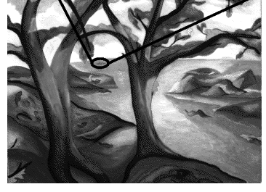
Grayscale Image

Slide 9
True color images
A true color image is stored as an m-by-n-by-3 data array that defines red, green, and blue color components for each individual pixel.
The RGB color space is commonly used in computer displays

Slide 10
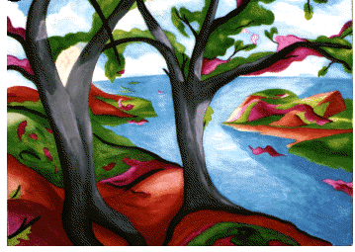
True color Image

Slide 11
Types of Operations
The operations that can be applied to digital images to transform an input image a[m,n] into an output image b[m,n]
  Point : the output value at a specific coordinate is dependent only on the input value at that same coordinate.
  Local : the output value at a specific coordinate is dependent on the input values in the neighborhood of that same coordinate
  Global : the output value at a specific coordinate is dependent on all the values in the input image

Slide 12
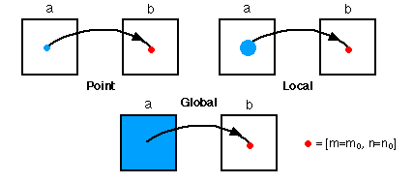
Types of image processing operations

Slide 13
Types of neighborhoods
Neighborhood operations play a key role in modern digital image processing
The neighborhoods are basically of two types
  4-connected
  8-connected
Two types of sampling schemes are
  Rectangular sampling - In most cases, images are sampled by laying a rectangular grid over an image
  Hexagonal sampling - An alternative sampling scheme

Slide 14
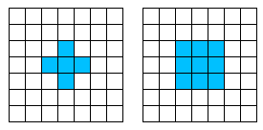
(a)
(b)
Types of neighborhood (a) 4 connected (b) 8 connected

Slide 15
Global Operations
Binarization: Reduction of gray-scale image to binary
Image Profiling: Histogram of ON-valued pixels summed across rows or columns of a binary image
Frequency Analysis: Images are often characterized not by particular objects but by the global configuration of all image objects and resulting patterns or texture.

Slide 16
Frequency Distributions and Histograms
  A tool that is used often in image analysis
  A histogram is a graphical representation of a frequency distribution showing the class intervals horizontally (x-axis) and the frequencies vertically (y-axis)

Slide 17
Histogram Features
It gives the presence of occupied bins. If there is only one bin then image is featureless.
It gives the range of intensity levels defined as the difference between minimum and maximum pixel values represented in the histogram.
  This helps to make appropriate adjustment to the scanning device to optimize contrast by taking advantage of the full range of intensity values available for a given display device.
  Contrast enhancement or histogram stretching technique can be used.
Another feature is the number of peaks. Large pixel count represents the image background and indicates that fraction of the field of view occupied by background exceeds that occupied by foreground objects.

Slide 18
Global Enhancement
Image contrast at a pixel can be defined as the difference between its intensity value I(x,y) and the average background intensity avg(I) normalized by the full intensity range
    C(x,y) = (I(x,y) – avg(I))/ (I_{max} – 0)
Three types of histogram transformations
  Histogram Expansion
  Output Histogram Specified
  Histogram Transformation Specified

Slide 19
Histogram Expansion
This is a most straightforward transformation technique.
It is a linear transformation that entails stretching the nonzero input intensity range, xє[x_{min}, x_{max}] to an output intensity range, y є[y_{min}, y_{max}] to take the advantage of full dynamic range, typically 0 to 255.
Each intensity value x is mapped to an output intensity value y by
  y = (x - x_{min}) * (y_{max} – y_{min})/(x_{max}- x_{min})

Slide 20
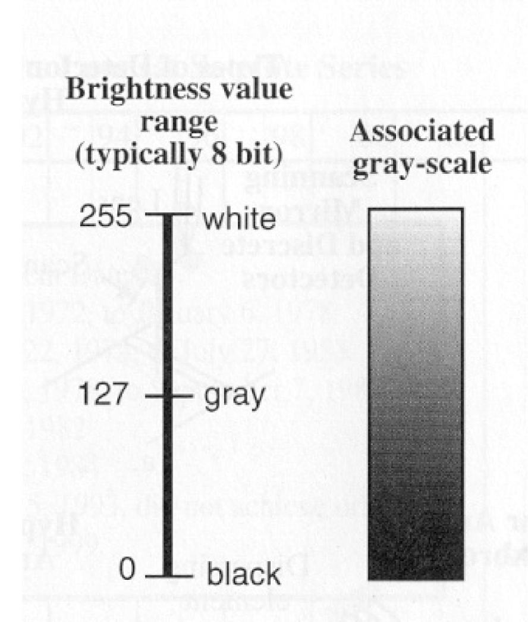
To create an image using a raster of data, you assign different shades of gray to the digital numbers

Slide 21
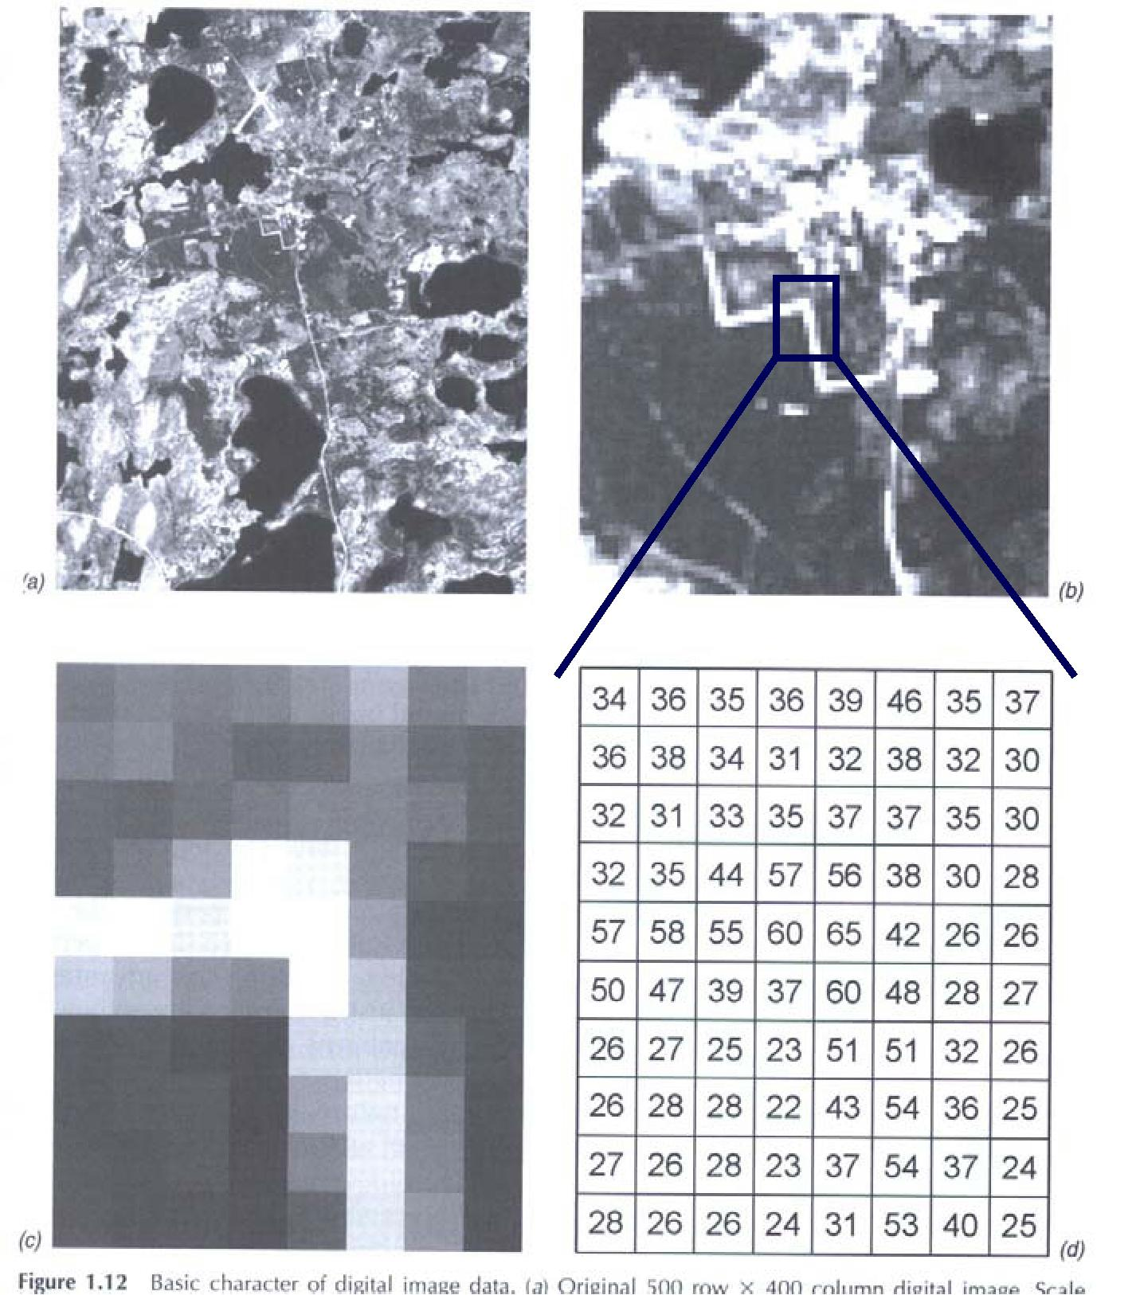
Digital images taken from space

Slide 22
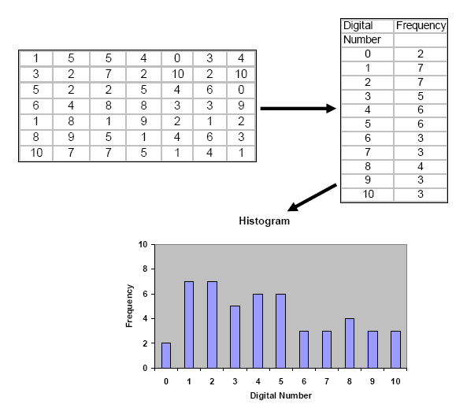

Slide 23
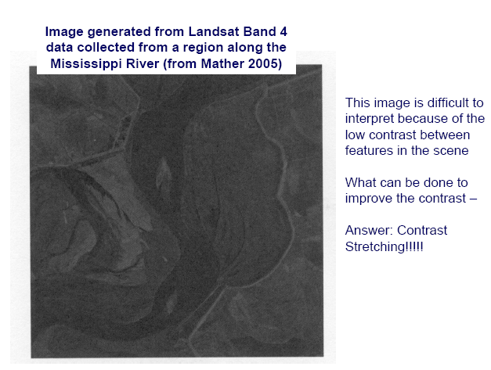

Slide 24
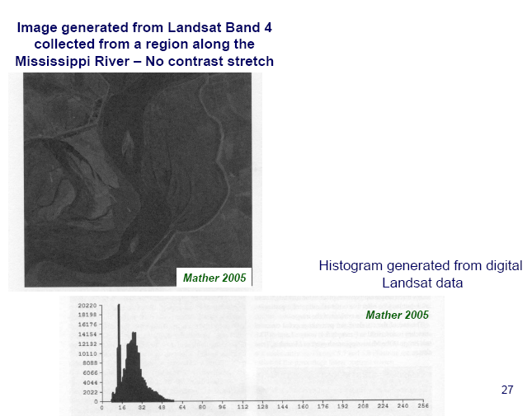

Slide 25
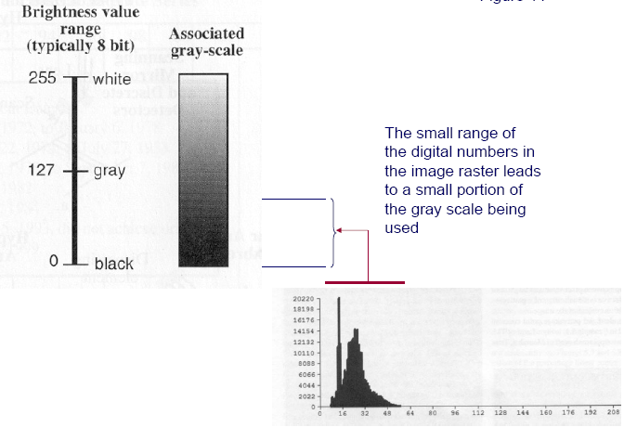

Slide 26
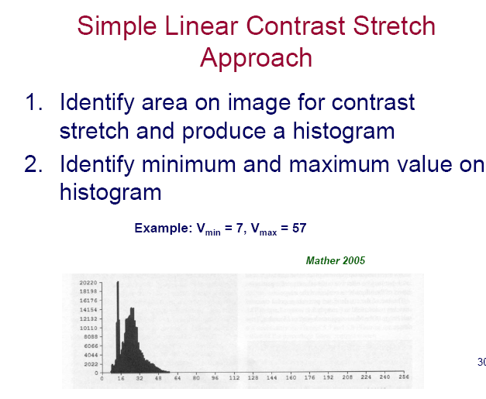

Slide 27
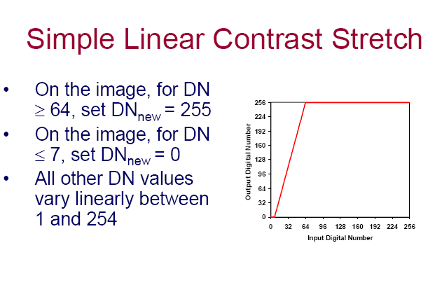

Slide 28
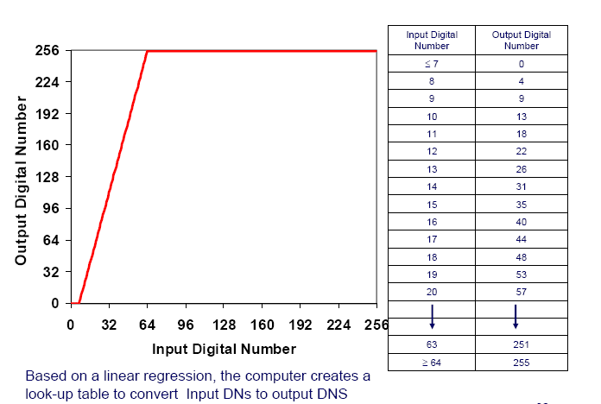

Slide 29
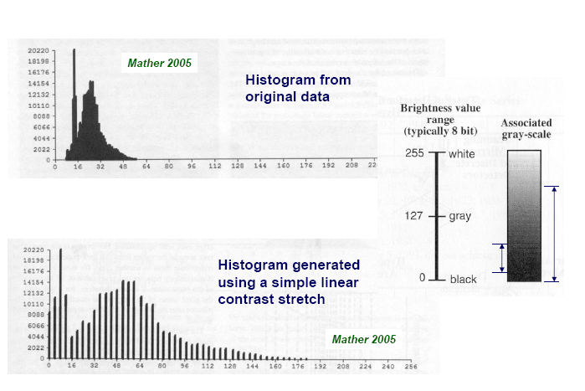

Slide 30
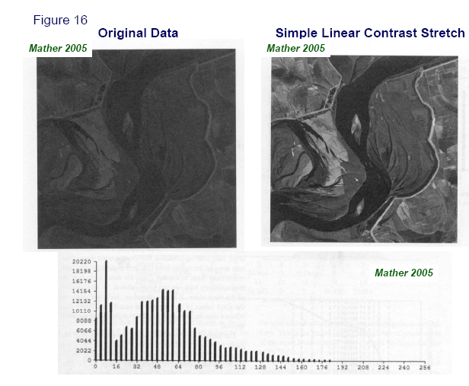

Slide 31
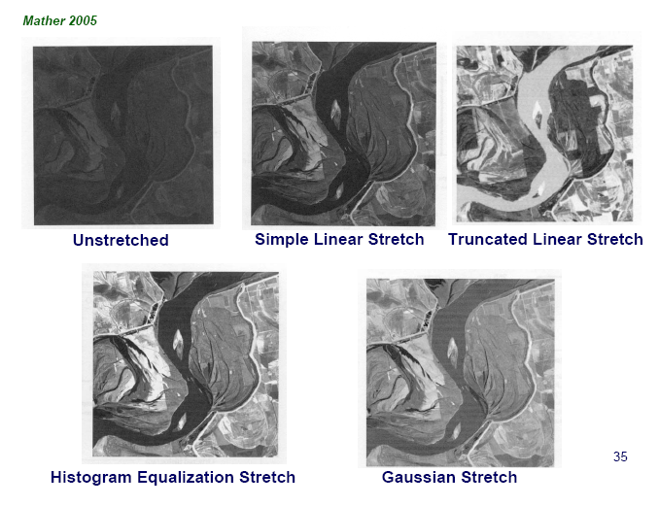

Slide 32
Output Histogram Specified
This type of transformation is defined by specification of the shape of the output histogram.
It produces a mapping to an output histogram that has the shape of a linear ramp.
For a positive slope, the range of occupied bins in the low-intensity range is stretched and contrast is enhanced.
For negative slope, the range of occupied bins in the high-intensity range is stretched and contrast is enhanced.
The case of zero slope corresponds to histogram equalization. It treats contrast equally over all intensity range
This type of transformation is useful for automatic enhancement because output shape is independent of input shape

Slide 33
Output Histogram Specified
It provides a convenient way to normalize the intensity distribution- to that specified output shape.
Normalized images help to make the comparison.
The function that maps the input histogram to a ramp-shaped histogram depends on the slope m of the ramp on the range of output intensity y є[0, y_{max}] and on the partial sum T(x) of bins from x = x_{min} to x in the input histogram:
  T(x) = Σ H(X) – 0.5(H(X_{min}) + H(X_{max}))
where H(x) is the bin height of x and X_{min} and X_{max} are the positions of the lowest and highest occupied bin respectively.

Slide 34
Output Histogram Specified
Assume T_{max} = T(x_{max})
y_{max}/2 – T_{max} /(m* y_{max}) - sqrt((T_{max} /(m* y_{max}) - y_{max}/2)² + 2T(x)/m) if m < 0
y = y_{max} T(x) / T(x_{max}) if m =0
y_{max}/2 – T_{max} /(m* y_{max}) + sqrt((T_{max} /(m* y_{max}) - y_{max}/2)² + 2T(x)/m) if m > 0
Generally m is set as follows:
For high intensities set m = -2 T/y_{max}²
For low intensities set m = 2 T/y_{max}²
For all intensities equally, set m =0

Slide 35
Histogram Transformation Specified
This type of transformation needs the explicit specification of a mapping function which produces output histogram.
Given a range of input intensities, xє[x_{min}, x_{max}] and output intensities, y є[0, y_{max}], a third degree polynomial y_{s} = A * x³ + B * x² + C * x + D can be used to map input intensities x to output intensities y_{s} where
A = (1-m)/(x²_{max} – 3 x_{c} * x_{max} + x_{c} ²)
B = - 3 * x_{c}
C = m + 3 * A * x_{c}²
D = 0
Where x_{c} is the chosen intensity value or the average intensity in a region of interest.
If y_{s} exceeds y_{max} then it is set to y_{max}

Slide 36
Arithmetic Operations on Images
I1 and I2 are two images of same dimension
Addition: I(x,y) = min(I1(x,y) + I2(x,y), I_{max})
Subtraction: I(x,y) = max(I1(x,y) - I2(x,y), I_{min})
Possibility of overflow and underflow and are taken care by clipping.
Clipping can be avoided by rescaling the range of intensity values encountered in both input images.
Modified Addition: I(x,y) = (I1(x,y) + I2(x,y))*255/(I1+I2)_{max}
Modified Subtraction: I(x,y) = (I1(x,y)-I2(x,y))*255/(I1-I2)_{min}

Slide 37
Arithmetic Operations on Images
I1 and I2 are two images of same dimension
Division: I(x,y) = I1(x,y) / I2(x,y), I2(x,y) <> 0
Pixels with zero intensity are removed by adding a constant of unity to produce I3= I2 +C, C=1.
Division of two images with comparable intensity distribution leads to small and possibly non-integer output values and therefore requires the scaling of the output images to the full dynamic range of the display device, say [0,255]
Modified Division: I(x,y) = (I1(x,y) / I3(x,y))*255/(I1/I3)

Slide 38
Logical Operations on Binary Images
I1 and I2 are two binary images of same dimension
Operation סּ: I(x,y) = I1(x,y) סּ I2(x,y)
where סּ is a logical operator AND, OR, XOR
AND: a AND b = 1 if a = b = 1
OR: a OR b = 1 if a =1 or if b =1
XOR: a XOR b = 1 if (a =1, b =0) or (a=0, b=1)
NOT, NAND and NOR are of not much use.

Slide 39
Geometric Image Transformation
Scaling and Rotation are two types of transformations
Geometric Interpolation
  Nearest Neighbour Method
  Interpolation Techniques: Linear, bi-linear, cubic spline etc.

